Slide 1
Voting Systems

Slide 2
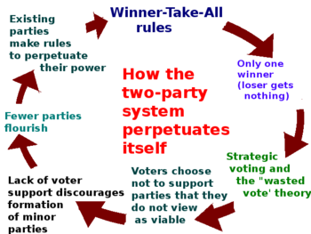

Slide 3
What are the benefits of PR compared to SMDP?
More representative
Could encourage more engagement
Focuses more on ideology, rather than location

Slide 4
What are the benefits of SMDP compared to PR?
More centrists
Encourages moderation (discourages extremism)
Focuses more on geographic localities.

Slide 5
STATE | DEMOCRATS Votes, (%) | REPUBLICAN Votes, (%) | RENT TOO D.H. Votes, (%)
1 | 500,000 (50%) | 300,000 (30%) | 200,000 (20%)
2 | 500,000 (50%) | 300,000 (30%) | 200,000 (20%)
3 | 500,000 (50%) | 300,000 (30%) | 200,000 (20%)
4 | 500,000 (50%) | 300,000 (30%) | 200,000 (20%)
5 | 500,000 (50%) | 300,000 (30%) | 200,000 (20%)
6 | 500,000 (50%) | 300,000 (30%) | 200,000 (20%)
7 | 300,000 (30%) | 500,000 (50%) | 200,000 (20%)
8 | 300,000 (30%) | 500,000 (50%) | 200,000 (20%)
9 | 300,000 (30%) | 500,000 (50%) | 200,000 (20%)
10 | 300,000 (30%) | 500,000 (50%) | 200,000 (20%)
Total # of votes | 4,200,000 | 3,800,000 | 2,000,000
Total % of votes | 42% | 38% | 20%
Under a plurality, (winner take all system), how many representatives does each party get? (Out of a total of 10)
Under a proportional representation system, how many representatives does each party get? (out of a total of 10)

